Slide 1
Midterm Presentation
Presented by,
Moustapha Sy Dieng (mxd152830)
Trung Hieu Tran (txt171930)
Ponmalar Silambaram Chandrabose (pxs162030)

Slide 2
Project Setup
We opted to use the following configuration:
IDE: Eclipse Oxygen
Java version: JDK 1.8
Build system: Apache Maven 3.5.3
Version control: GitHub

Slide 3
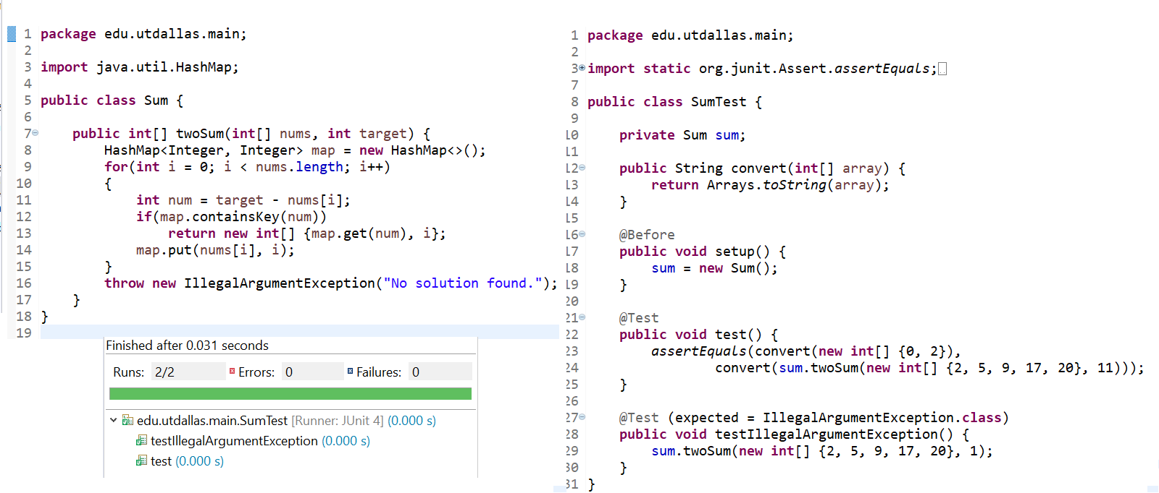
Project Setup (contd)
Once we setup the environment, we created a small program along with a couple of test cases to ensure we were able to run unit tests properly

Slide 4
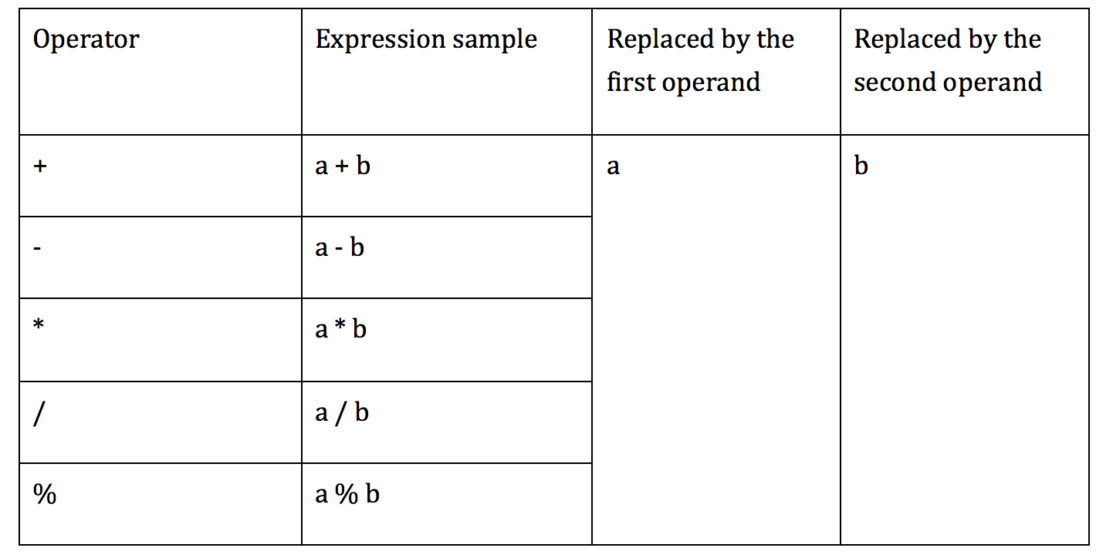
AOD implementation
AOD is replaces an arithmetic expression by each one of the operand

Slide 5
AOD implementation
First operand replacement:
remove the first parameter from the stack of JVM which is associated with the second operand in the expression
int, float stored in 1 stack slot : POP
double, long stored in 2 stack slots: POP2

Slide 6
AOD implementation
Second operand replacement:
int, float:
using SWAP
becomes the first operand replacement

Slide 7
AOD implementation
Second operand replacement:
double, long:
SWAP2 doesn’t exist
Alternative:
DUP2_X2
POP2
POP2

Slide 8
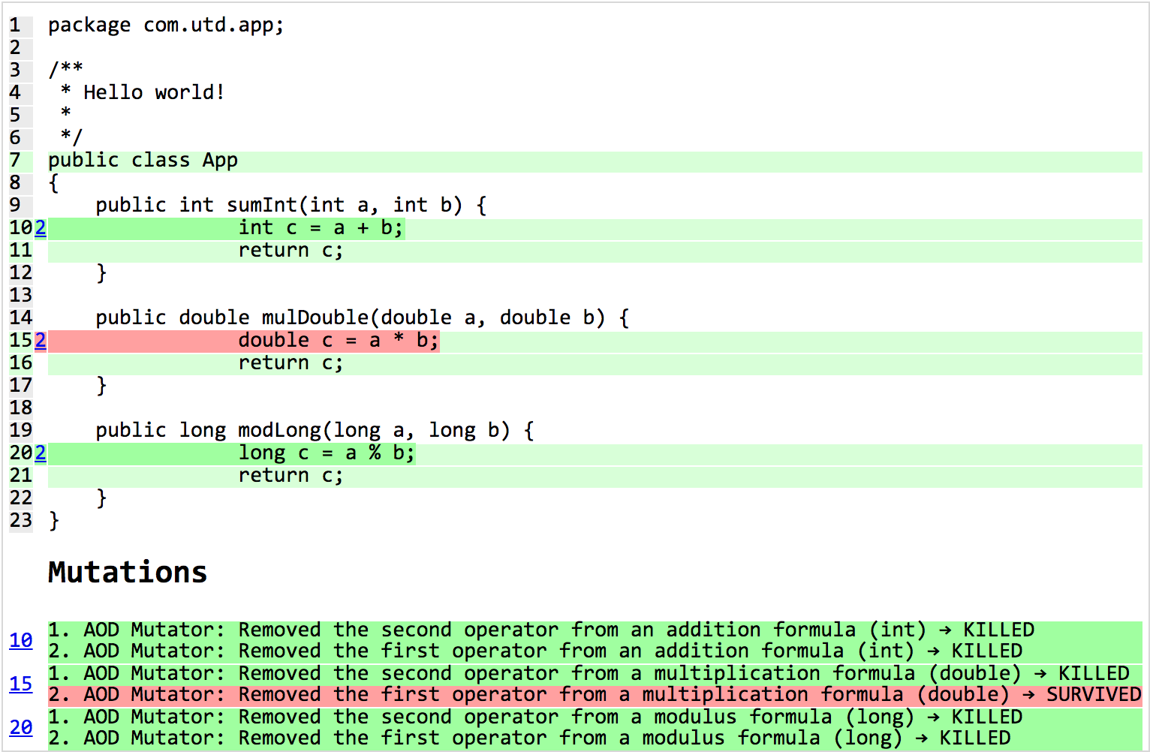
Example

Slide 9
AOR implementation
AOR replaces every arithmetic operator with every other operator.
All the possible replacements:
+ | - | * | / | %
- | * | / | % | +
* | / | % | + | -
/ | % | + | - | *
% | + | - | * | /
Bitwise OR | Bitwise AND | Bitwise XOR
Bitwise AND | Bitwise OR | Bitwise AND
Shift Left | Shift Right | Unsigned Shift Right
Shift Right | Shift Left | Unsigned Shift Left

Slide 10
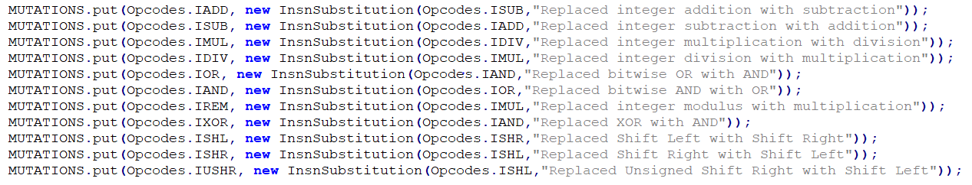
AOR implementation
We followed the same approach used by the existing mutators that perform similar replacement
Below is a snippet of Integer value operator and bitwise operator replacement

Slide 11
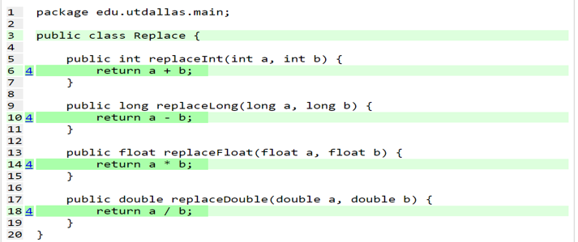
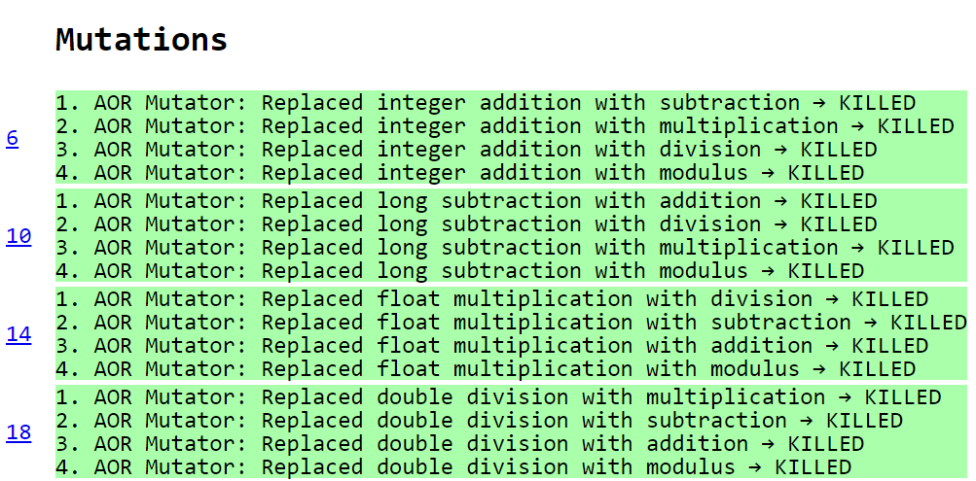
Example (Replace.java)

Slide 12
ROR Implementation
The implementation of the relational operator replacement required for each relational operator to be replaced by every other one.
We used the same approach as the mutators dealing with relational operators such as Conditional Boundary Mutator.
== | != | >= | > | <= | <
!= | >= | > | <= | < | ==
>= | > | <= | < | == | !=
> | <= | < | == | != | >=
<= | < | == | != | >= | >
< | == | != | >= | > | <=

Slide 13
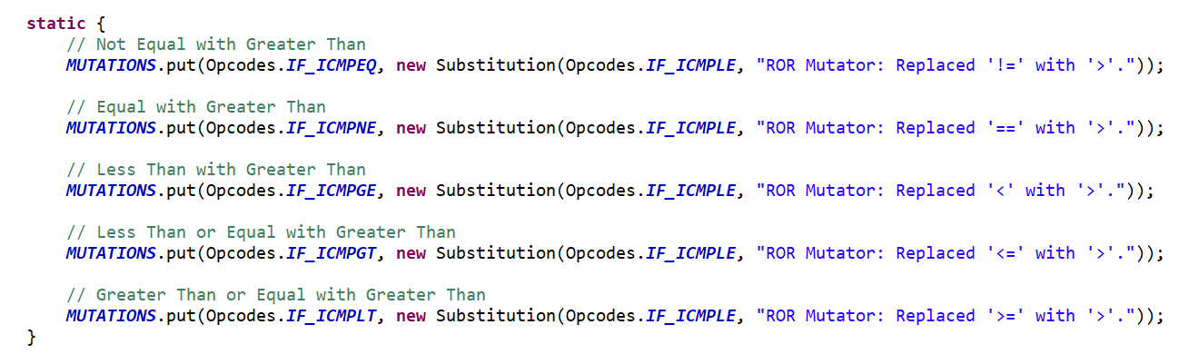
ROR Implementation
Created a class containing six enum types, each implementing the MethodMutatorFactory.
Each enum created a MethodVisitor that handled a certain case.
Each method visitor extended AbstractJumpMutator which contain the Substitution class used for replacement.
Snippet of the method visitor that handled the replacement of operators to java code ‘>‘.
Note the opcodes are the exact opposite of the operators.

Slide 14
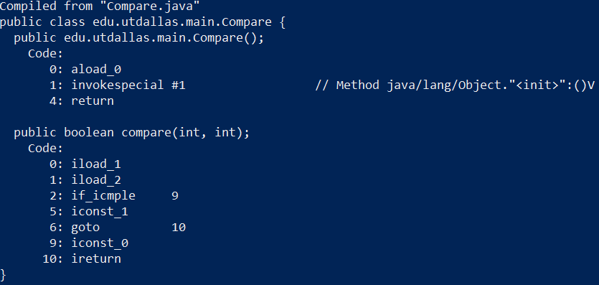
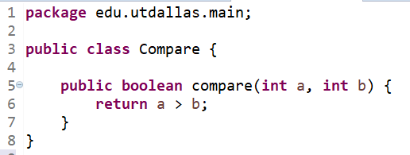
ROR Implementation
First, the two parameters are loaded into the operand stack.
Then, i_icmple compares the top two values on the stack.
It branches to byte code 9 if comparison is true. This returns false.
It continues to byte code 5 if comparison is false. This returns true.

Slide 15
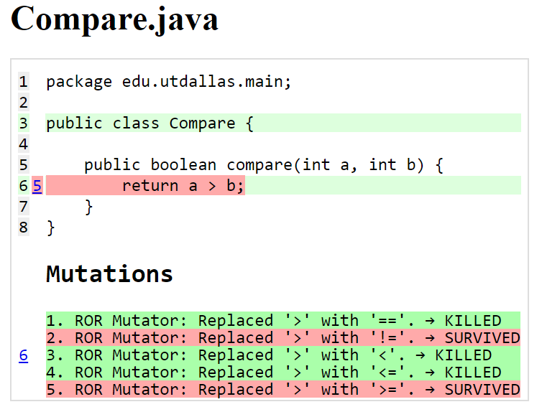
ROR Implementation

Slide 16
Test results
Projects from GitHub | Number of Classes | Line Coverage |  | Mutation Coverage
 |  | % | coverage line | % | Killed/No.of mutation
zt-exec,305172eaed27aa71a6f4de970d20c73cefe6291e,https://github.com/zeroturnaround/zt-exec | 5 | 67% | 277/414 | 25% | 19/75
aho-corasick,25eeef5168846d50dc343c1f224a24745f925f5b,https://github.com/robert-bor/aho-corasick | 6 | 96% | 240/249 | 77% | 206/267
GoogleAuth,7051a9a23913c9ef3808467b1c647cab7ada82cf,https://github.com/wstrange/GoogleAuth | 4 | 71% | 188/263 | 58% | 102/176
RestFixture,bb4c7071c4edfd9f4aac8c6dd3aee1b196ffa0f1,https://github.com/smartrics/RestFixture | 12 | 73% | 803/1095 | 54% | 68/126
pollexor,0255b9bbd0163dc2e3c86b3bfc9127ecf3a01cfc,https://github.com/square/pollexor | 2 | 89% | 248/278 | 85% | 241/283
rtree,e406cff766740b117898d6777c094ed494220fa5,https://github.com/davidmoten/rtree | 71 | 80% | 1939/2424 | 65% | 1238/1905

Slide 17
Thank you!

